Slide 1

Emotion Detection
Project Supervisior: Dr. S.Jancy, M.s, Ph.d
Name of the student: Mr. Sravana Srikanth
Register Number: 39110985

Slide 2
HCL INTERNSHIP CERTIFICATE

Slide 3
INTRODUCTION
Emotions control your thinking, behavior and actions
Emotions affect your physical bodies as much as your body affects your feelings and thinking.
People who ignore, dismiss or repress their emotions, are setting themselves up for physical illness.
If someone showed you a picture/audio/video of a person and asked you to guess what they’re feeling, chances are you’d have a pretty good idea about it. What if your computer could do the same?
Here we predict the emotion using machine learning and deep learning.

Slide 4
ABSTRACT
To provide better services and also better Human-machine interactions
Facial/Face Emotion Recognition(FER) is useful in most of the applications such as healthcare, teaching, criminal investigation, Human Robot Interface (HRI), etc.
Speech Emotion Recognition(SER) plays as important role in voice selection models actor training, call centers etc.
Image Emotion Recognition(IER); similar to FER is also used in this project for the better analysis. {Here image represent to human face}
Predicting the emotion

Slide 5
PROJECT STATEMENT
Predicting human emotion and recognizing its types through image sample, audio sample and video sample.
As emotions play a vital role in communication, the detection and analysis of the same is also a major importance in today’s digital world of remote communication.
Emotion of a certain person prediction? How can it be predicted with machines and solve it.

Slide 6
OBJECTIVE
The main objective of this project is to take you through the entire working pipeline that you may follow while approaching a Machine/Deep Learning problem.
Applying multiple algorithms to analyse the model, evaluate the model using various performance metrics and predicting the emotion which is suitable for the data.
Improvising the model by adding GUI screen and make use as a real-time application is my main objective.

Slide 7
REQUIREMENTS
Operating System : Windows OS(7/8/9/10/11)
Processor : i3 or more
Coding Language : Python
Coding Platform : Jupyter Notebook
A computer with good network access.
Make sure that the files are uploaded correctly in directory. So that you can access the audio file/video file/ image file.
Install all the required libraries.

Slide 8
Libraries
Pandas, numpy, librosa, soundfile, cv2, noisereduce, soundfile, os python_speech_features, tensorflow, scipy, sklearn, numba, csv matplotlib, pillow, scikit-learn, glob, pickle, requests, tkinter, pyaudio, warnings, struct, wavfile, ffmpeg etc.

Slide 9
DATASET INFORMATION
Here we use different dataset for analysing emotions.
RAVDESS for Speech emotion recognition(SER)
Here we have 24 actors voice/speech in different kinds of emotions.
Each actor file consist of 60 audio files with different emotions.
For Facial recognition we use a dataset from Kaggle i.e. fer2013
To detect emotion in an image and video we use this dataset.
Since video means broadcasting of a visual images.

Slide 10
CHAPTERS
Chapter 1 :- Speech emotion recognition
Chapter 2 :- Image emotion recognition
Chapter 3 :- Video emotion recognition

Slide 11
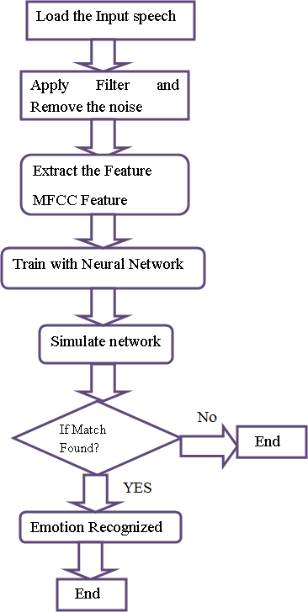
CHAPTER - 1
SYSTEM ARCHITECTURE

Slide 12
IMPLEMENTATION
At first we need the audio files so for that we are using ‘RAVDESS’ dataset
With the help of librosa we can load audio files and by using pyaudio,sound file we can load audio file and make changes to it.
Just clear the future warnings as it may affect your output.
Make sure that for loading the file we should be accessed for working directory or the path where dataset is stored.
Load the dataset
Make sure that we have loaded the data correctly and just print the filenames including actors for verification.
Create a data frame with labels and paths.

Slide 13
IMPLEMENTATION
At first plot/draw the spectrogram and waveform for the first 7 actors; so that we have a clear analysis regarding it(only the initial audio of 7 actors).
After wards plot spectrogram and waveform for all the actors audio files. This might take some time (Interrupt the code if needed).
Using Speech Recognition API convert audio to text (Interrupt if needed).
Deep visualization process occurs int his stage. Now plotting mfcc and logfbank; a linear cosine transform of a log power spectrum.

Slide 14
IMPLEMENTATION
Plot mfcc (Interrupt the code if needed).
Clean the data set by using cleaning and masking to remove the unwanted noise or the background noise and store these wav files in a clean_speech folder(Should access this folder).
Apply the extraction feature to this clean speech. Here I have used chroma, mel, mfcc(we can also include contrast and torrentz in it).
After applying feature extraction. We will be splitting the clean speech dataset into testing and training.
Apply the Muti Layer Perceptron classifier to it.

Slide 15
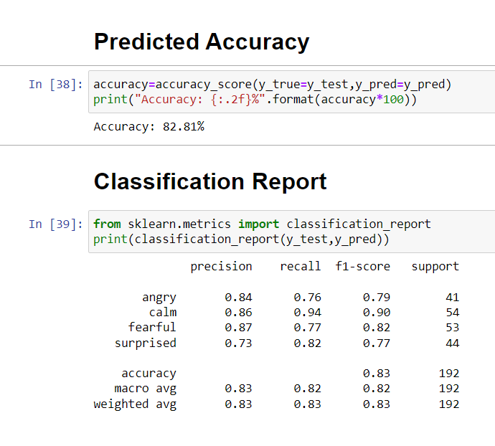
PREDICTION AND ACCURACY
Save the Model to file in the current working directory for new testing data other than the data in dataset.
After evaluating metrics we get precision, f1score, accuracy of 82.81% and we will label it in the classification report.
Using pickle and glob save the model in a
pkl file for testing live audio.
Apply the extraction feature for live audio
and predict the result.

Slide 16
CONCLUSION
We got training accuracy of 82.81% for the cleaned speech.
For the original dataset (without cleaning action), we have predicted training accuracy of 75.4% which is less better compared to clean speech.
Here we have given best inputs to perform and have better result.
We used mlp classifier which is suitable for this model and we can predict the value efficiently.
Another model is a neural network model; a deep learning convolutional model takes more time for processing and also should have best graphics card to speed up the process outcome.

Slide 17
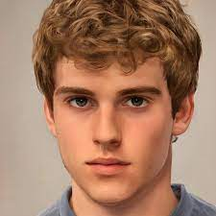

CHAPTER - 2
SYSTEM ARCHITECTURE
Using deep face
Predict emotions

Slide 18
IMPLEMENTATION
Here I used a simple program for the image emotion detection.
First take a image in the form of jpg, img or jpeg format and make sure it contains human photo in it.
Now by using deep face library we get the external face recognition an dits emotion
DeepFace is a deep learning facial recognition system created by a research group at Facebook.
Here we can also predict the age of that person and which country belongs to etc.

Slide 19
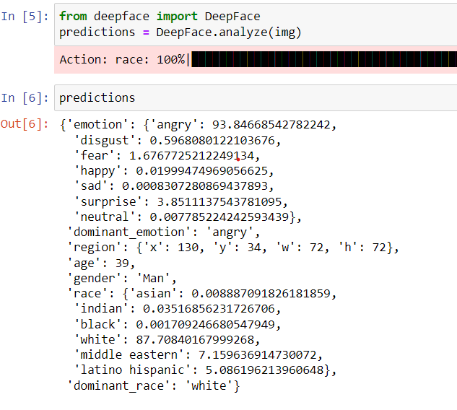
Implementation

Slide 20
CONCLUSION
Regarding this we use simple library deep face to perform the predictions over an image.
At next we use harcascade model for open cv and loading the live image.

Slide 21
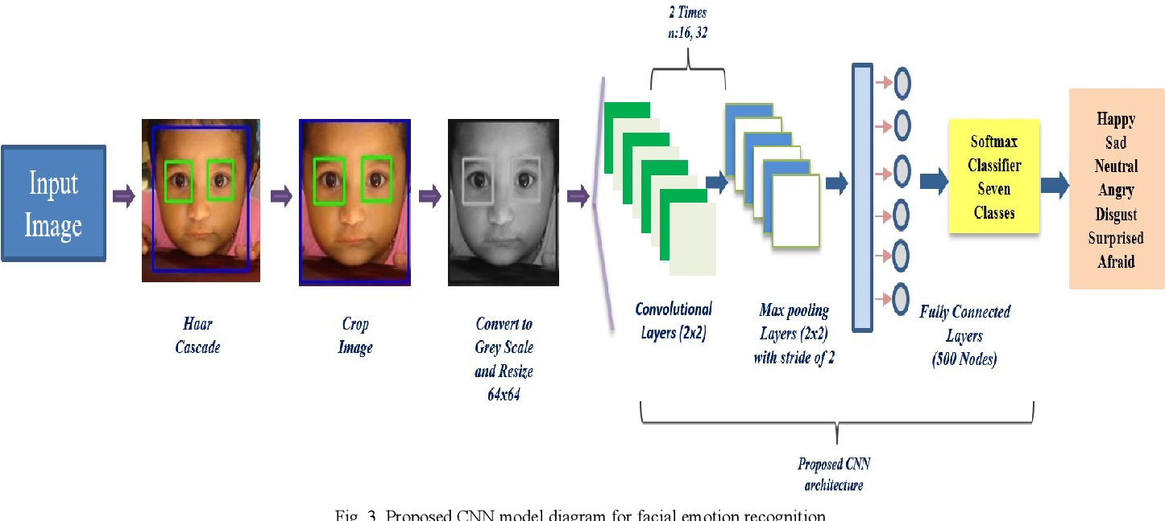
CHAPTER - 3
SYSTEM ARCHITECTURE

Slide 22
IMPLEMENTATION
First, we need to enable GPU in the Google Colab/Jupyter notebook to get fast processing(if needed).
Once it is enabled we will now import the required libraries for building the network.
After importing we have to read the data frame.
We then create different lists of storing the testing and training image pixels.
After this, we check if the pixel belongs to training then we append it into the training list & training labels.
Similarly, for pixels belonging to the Public test, we append it to testing lists.

Slide 23
IMPLEMENTATION
Once we have added the pixel to the lists then we convert them into NumPy arrays and reshape X_train, X_test.
Now it’s time to design the CNN model for emotion detection with different layers.
We start with the initialization of the model followed by batch normalization layer and then different convents layers with relu as an activation function, max pool layers, and dropouts to do learning efficiently.
After this, we compile the model using Adam as an optimizer, loss as categorical cross-entropy, and metrics.
Once the training has been done we can evaluate the model and compute loss and accuracy.

Slide 24
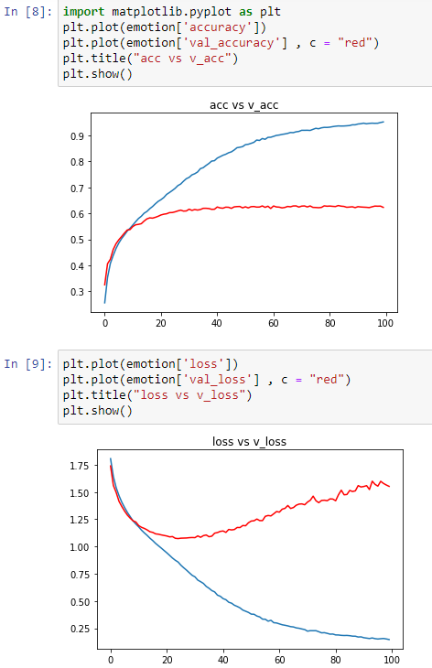
IMPLEMENTATION
We now serialize the model to JSON and save
the model weights in an hd5 file so that we can
make use of this file to make predictions rather
than training the network again.

Slide 25
CONCLUSION
Set of images together form in a specified pattern is a video so from this we are training and testing the images.
Here I used a neural network model which is best for evaluating the metrics and then load into a json file and hdf5 /h5 file for analyzing new data without accessing directly into it.
Since GPU meter is more efficient role; it may take minutes or hours to perform this program.

Slide 26
FINAL CONCLUSION
Finally I predicted the emotion based on image/face analysis, speech analysis and video analysis.
Here I used the best models for the predicting the emotion.
Emotions observed mostly are: calm, happy, sad, angry, fear, surprised, disgust.

Slide 27
THANKYOU

